Slide 1

Answer Sheet Evaluation Engine
By Team 1,
Kspsvln Siddhardha Kumar Kavuri (1005-21-733058)
Mogadampalli Mani Datt (1005-21-733036)
Puli Venu (1005-21-733045)

Slide 2

Introduction to the Project
This project focuses on evaluating answer sheets for a course or exam. We will utilize various Python libraries to process the answer sheets and automatically assess their quality.

Slide 3
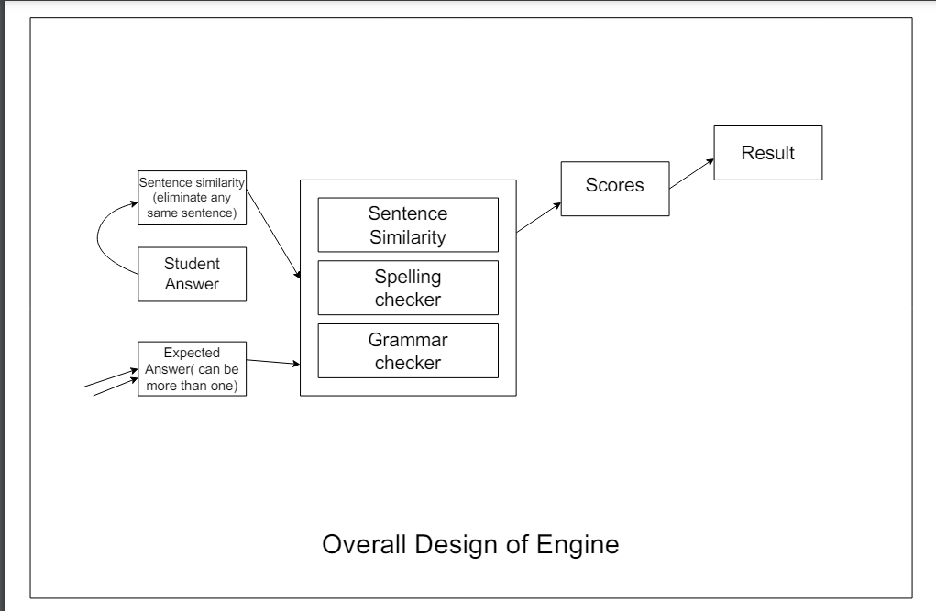
Over All Design Of Engine
Answer sheet evaluation engine design is as follows:

Slide 4

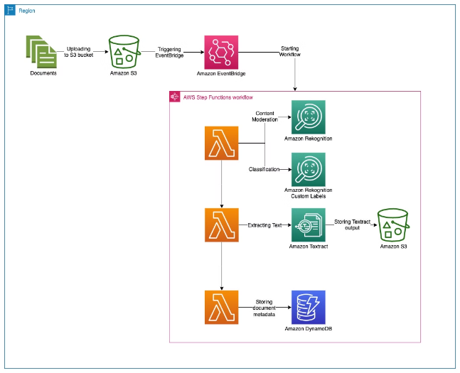
Amazon Textract: Document Analysis
Amazon Textract is a service that uses machine learning to automatically extract text and data from scanned documents. It can also identify tables and forms, and extract their data.
Textract can be used to automate tasks such as data entry, document processing, and information retrieval. This can save time and improve accuracy.

Slide 5

Spacy: Natural Language Processing Library
Spacy is a Python library for natural language processing (NLP). It provides tools for tokenization, part-of-speech tagging, named entity recognition, and dependency parsing. It also supports various languages, including English, German, French, Spanish, and Chinese.
Spacy is popular for its efficiency and ease of use. Its core functionalities are implemented in Python for fast performance. You can use Spacy to build applications for tasks such as sentiment analysis, text classification, and information extraction.

Slide 6


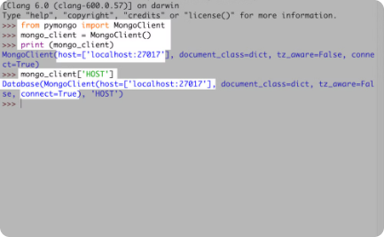
PyMongo: MongoDB Integration
MongoDB: NoSQL Database
PyMongo: Python Driver
Data Access
PyMongo is a Python library that provides a convenient interface for interacting with MongoDB databases.
PyMongo enables Python applications to connect, query, insert, update, and delete data within MongoDB collections.
MongoDB is a popular NoSQL database, known for its flexibility and scalability.

Slide 7
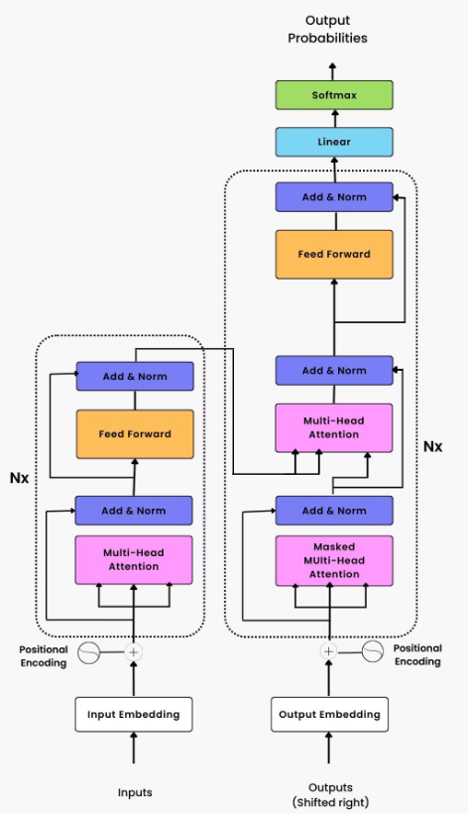
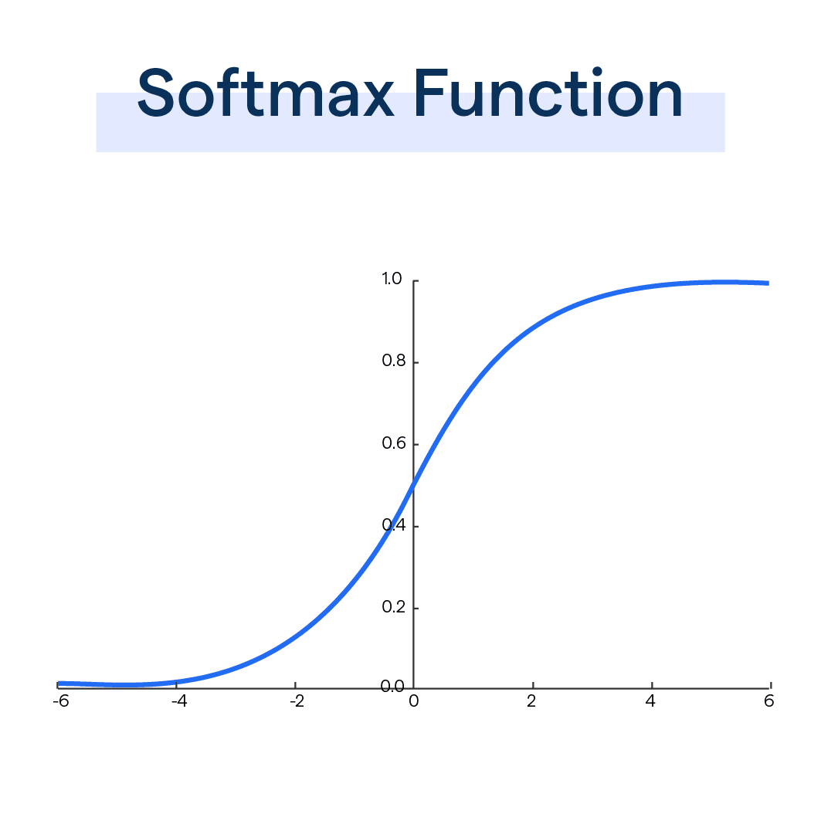
HappyTransformer: Transformer Models
HappyTransformer is a Python library for
using transformer models for natural
language processing tasks. It provides a
simple and user-friendly interface for
using these models. HappyTransformer
supports a wide range of transformer
models, including BERT, RoBERTa, GPT-2, and XLNet.
HappyTransformer can be used for
various NLP tasks, such as text
classification, question answering, and
text generation. It makes it easy to fine-
tune transformer models on your own
data and deploy them for production
use.

Slide 8
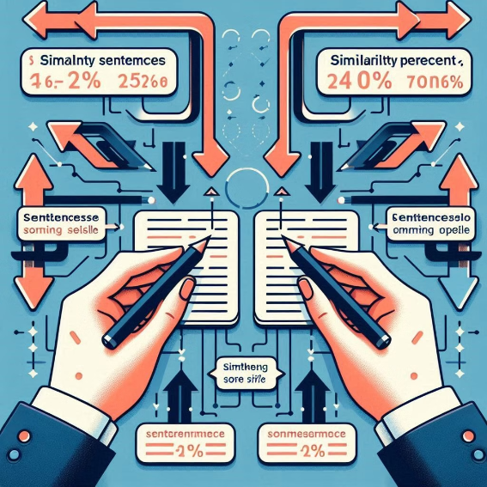
Sentence Transformer: Semantic Similarity
Sentence Transformer is a library that allows you to compute semantic similarity between sentences. It uses pre-trained models to encode sentences into vectors. The distance between these vectors represents the semantic similarity between the sentences. Sentence Transformer models are often used in natural language processing tasks such as question answering, text summarization, and sentiment analysis.

Slide 9
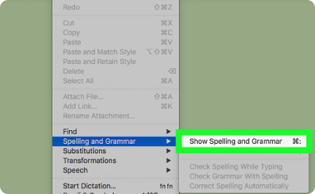


PySpellChecker: Spell Checking
Identifying Errors
Suggesting Corrections
Enhancing Text Quality
PySpellChecker identifies misspelled words in text by comparing them against a dictionary of correct spellings.
The library provides suggestions for the correct spellings of misspelled words, helping to improve text accuracy.
PySpellChecker helps ensure that text is free of spelling errors, improving readability and professionalism.

Slide 10




Test Cases and Demonstration
This section will provide practical examples demonstrating the implementation and application of the various Python modules used in the project.
We will showcase the functionality of each module through carefully curated test cases.
These test cases will illustrate how each module addresses specific NLP tasks, highlighting their strengths and capabilities.
Text Extraction
1
Extract text from various document formats.
Grammar and Spelling Checking
2
Analyze the grammar and spelling mistakes in text data.
Internal Semantic Similarity
3
Identify and compress the similar sentence in answer.
Semantic Similarity
4
Compare the meaning of different texts.
We will then proceed to demonstrate the integrated functionality of these modules by simulating a real-world use case.
This demonstration will showcase how these modules work together to achieve a comprehensive NLP solution.

Slide 11
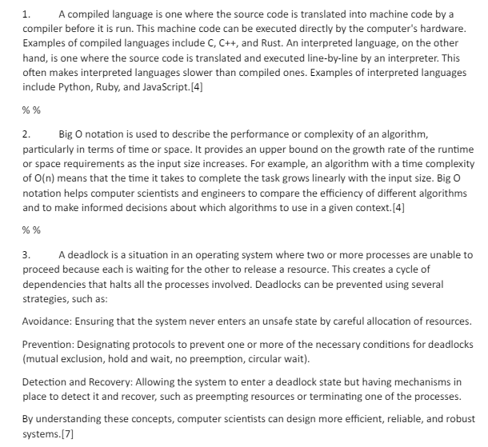
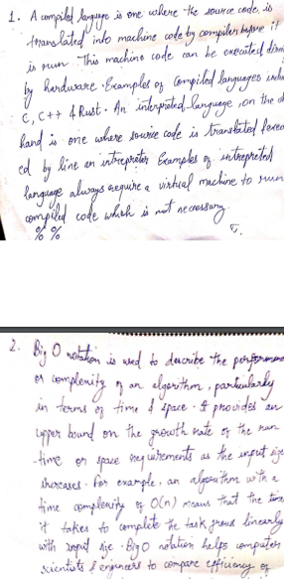
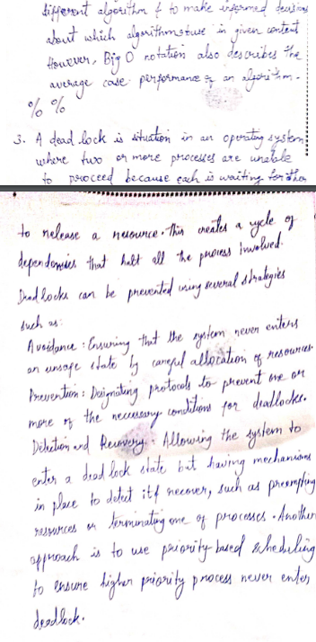
Test Cases and Demonstration

Slide 12
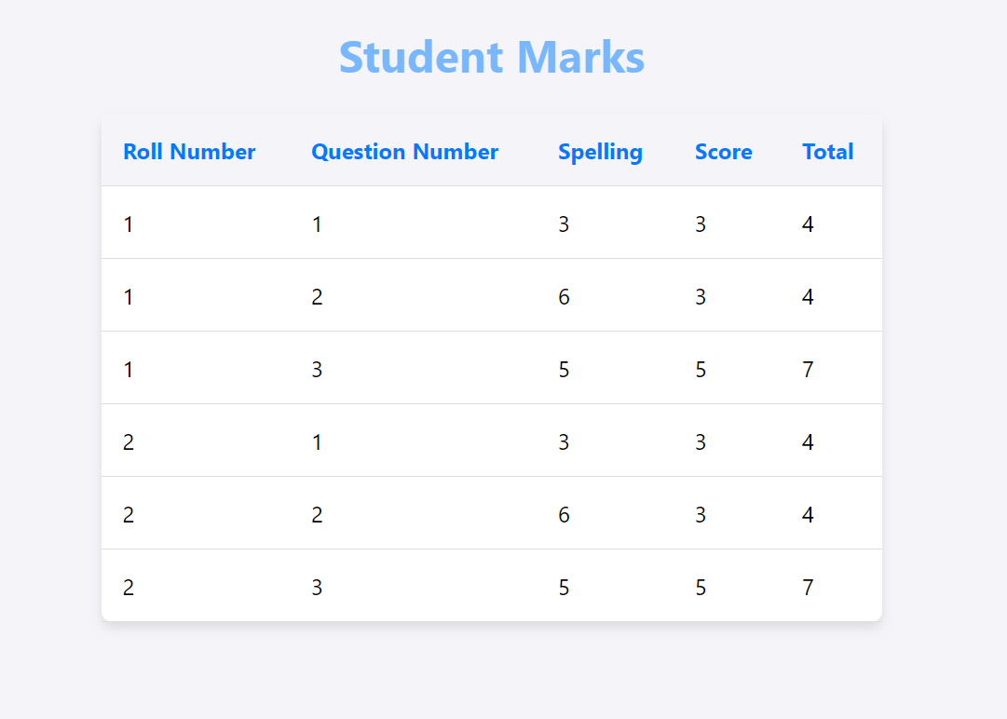
Result of Test Cases

Slide 13
Rules to be followed for accurate Evaluation of Paper
There are some protocols to be followed while writing answer :
For students writing answer, The question number and actual answer should be separated by . (dot or full stop) also the dot should be clearly visible other there would problem in evaluation.
For students writing answer, at the end of answer student should append “% %” symbol in the new line.
For evaluator using the project, there is some format that should be followed The question number and actual answer should be separated by . (dot or full stop) also the dot should be clearly visible other there would problem in evaluation.
For evaluator using the project, at the end of answer student should append “% %” symbol in the new line.
For evaluator using the project, total mark for question should be at the end of the answer in square brackets. Example answer.[marks]

Slide 14

Questions and Answers

